Slide 1


Buncombe County Community Survey Results
Presented by ETC Institute

Slide 2
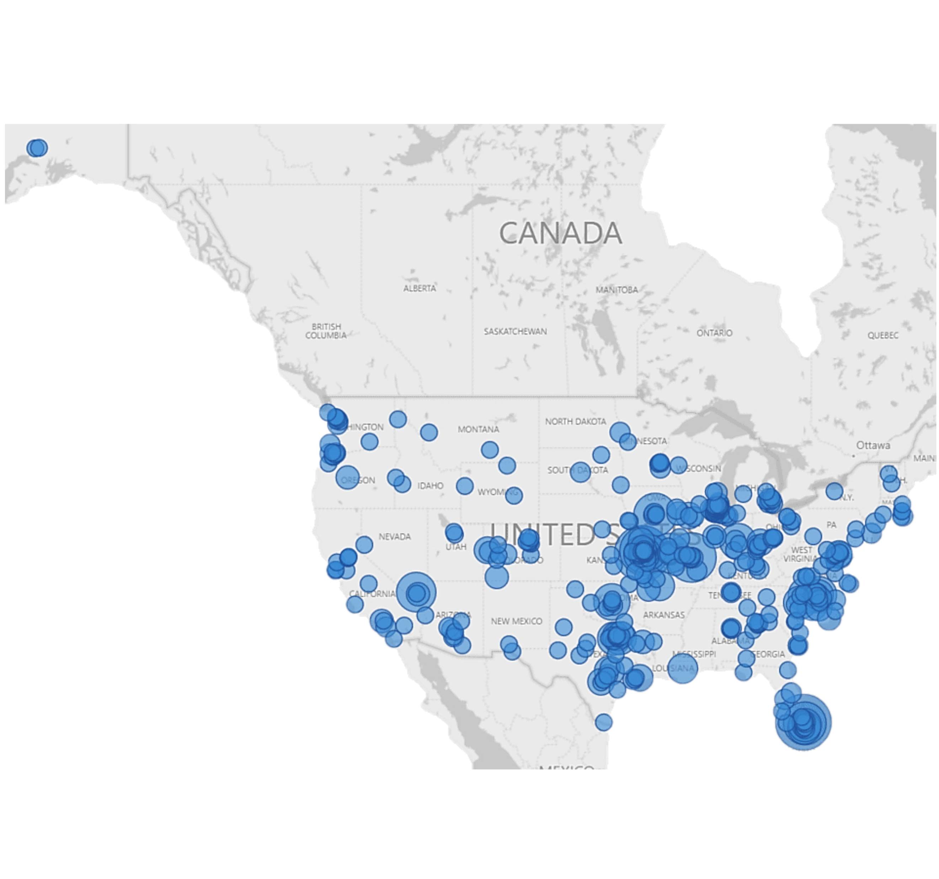
Since 2006,
ETC Institute Has,
In More Than 1,000 Cities
&
49 States, Surveyed More Than 3,000,000 Persons.
ETC Institute is a National Leader in Market Research for Local Governmental Organizations
For more than 35 years, our mission has been to help municipal and county governments gather and use survey data to enhance organizational performance.

Slide 3
Agenda
Purpose and Methodology
Things to Know
Major Findings
Summary
Questions

Slide 4
Purpose
To objectively assess resident satisfaction with the delivery of County services
To help determine priorities for the County
To compare your performance with other communities regionally and nationally

Slide 5
Methodology
Survey Description
  Seven-page survey
  First survey conducted for the County by ETC Institute
Method of Administration
  By mail and online to random sample of households in the County
  Each survey took approximately 15-20 minutes to complete
Notes:
Track demos/geography to ensure representation

Slide 6
Methodology
Sample Size and Sampling Goals
  Goal: 500 completed surveys
  Completed: 753 completed surveys (166% of goal)
Confidence Interval and Margin of Error
  Confidence Interval: 95% level of confidence
  Margin of Error: +/-3.5%
Notes:
EXPLAIN – why 500 completed surveys
Based on size of community and desire to enhance reliability across various subsets

Slide 7
Perceptions
Perceptions related to county services are mixed

Slide 8
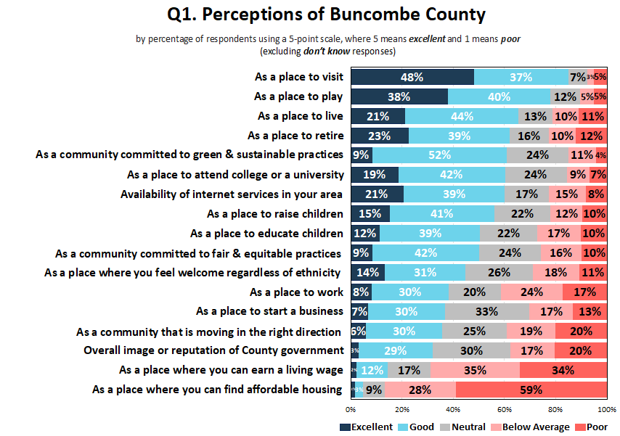
County priorities that residents indicated should receive the most emphasis received lowest ratings

Slide 9
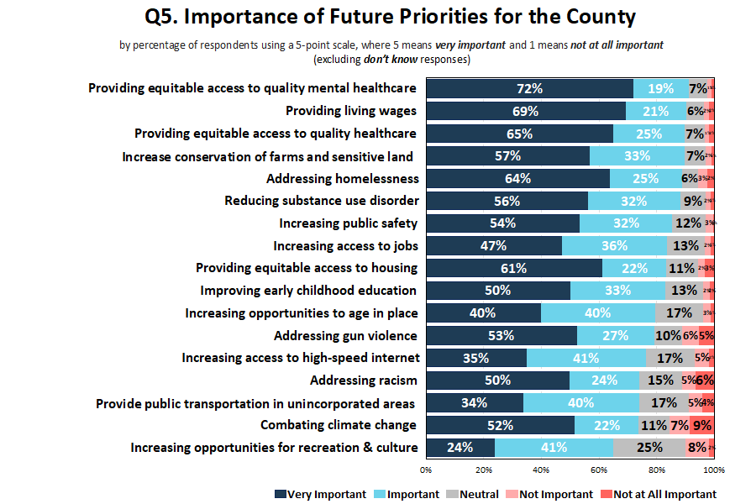
The priorities that are most important to residents aren’t the same priorities they want the County to emphasize

Slide 10
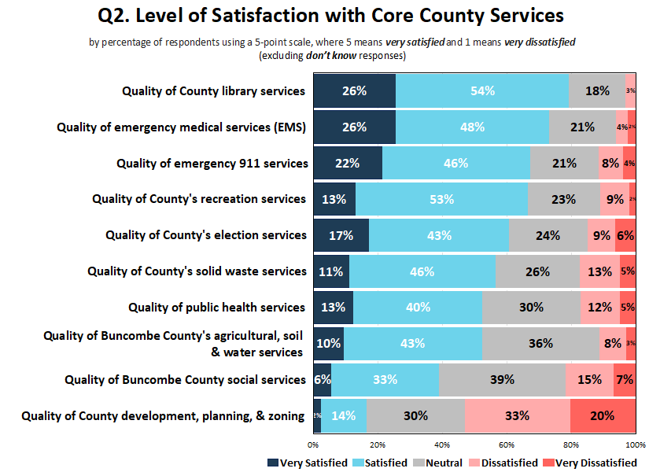

Slide 11
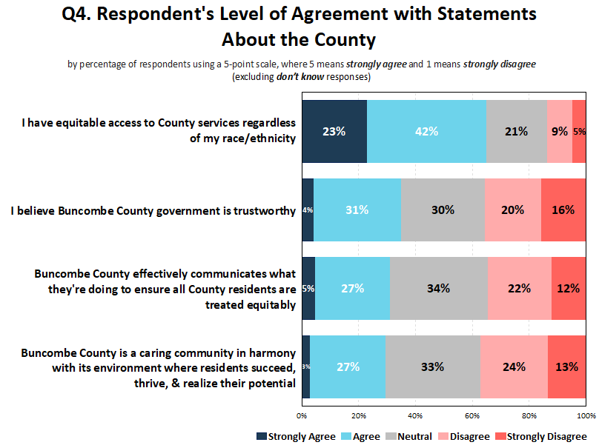
While the County equitably provides services residents disagreed at high rates with other statements

Slide 12
Benchmarks
Regional and National Comparisons

Slide 13
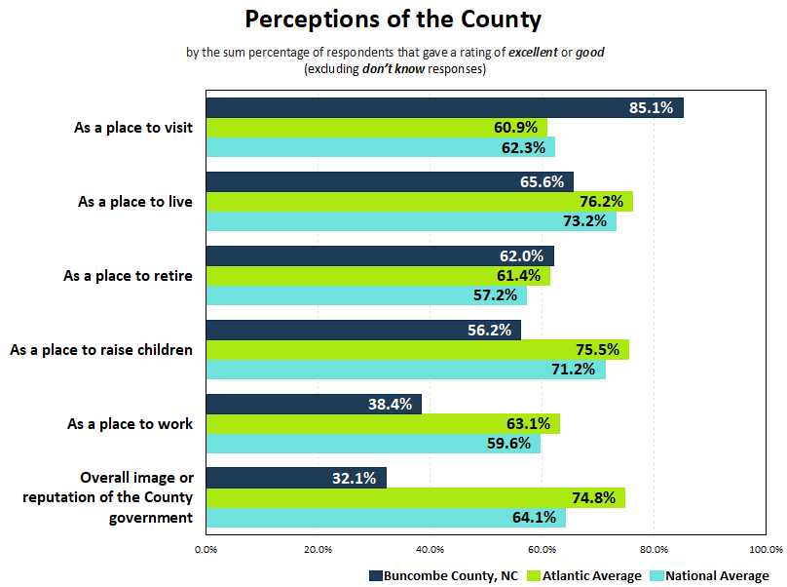
Higher than National Average: Lower than National Average:

Slide 14
Comparative Advantages
National Average
Atlantic Regional Average
As a place to visit
Quality of outdoor event facilities (e.g., picnic shelters) at County parks
Quality of recreation services
Quality of library services
As a place to retire
As a place to visit
Quality of outdoor event facilities (e.g., picnic shelters) at County parks
Quality of County athletic fields (soccer, baseball/softball)
Quality of recreation services
Quality of library services

Slide 15
Comparative Weaknesses
National Average
Atlantic Regional Average
Overall image or reputation of the County government
Efforts to be open & transparent with information about County issues, services, & performance
As a place to work
Effectiveness of County communication with the public
Quality of the County's cable television channel
Overall image or reputation of the County government
Efforts to be open & transparent with information about County issues, services, & performance
Effectiveness of County communication with the public
As a place to work
Timeliness of information provided by the County

Slide 16
Priorities for Investment
Importance-Satisfaction Analysis

Slide 17
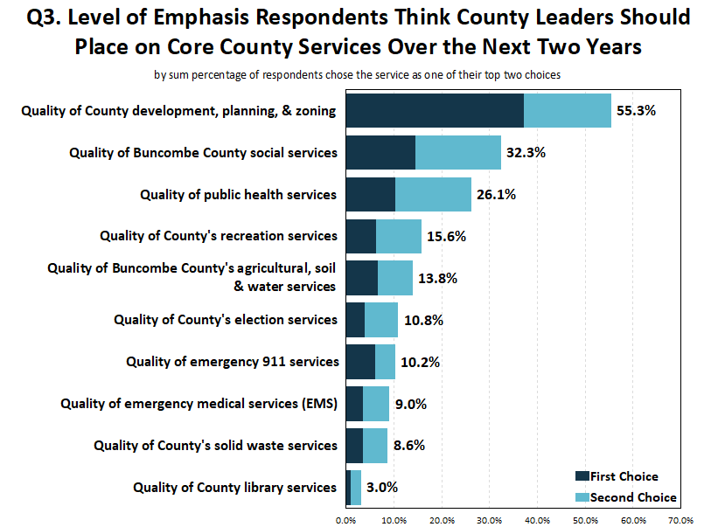

Slide 18
I-S Ratings .1000 or Greater Are Considered a High Priority for Investment Over the Next Two Years
Notes:
SMELL/TASTE - $500M OZONE TREATMENT FACILITY

Slide 19
I-S Ratings .1000 or Greater Are Considered a High Priority for Investment Over the Next Two Years
Notes:
SMELL/TASTE - $500M OZONE TREATMENT FACILITY

Slide 20
I-S Ratings .1000 or Greater Are Considered a High Priority for Investment Over the Next Two Years
Notes:
SMELL/TASTE - $500M OZONE TREATMENT FACILITY

Slide 21
Communication
The County is the primary source, but local tv news is a close second

Slide 22
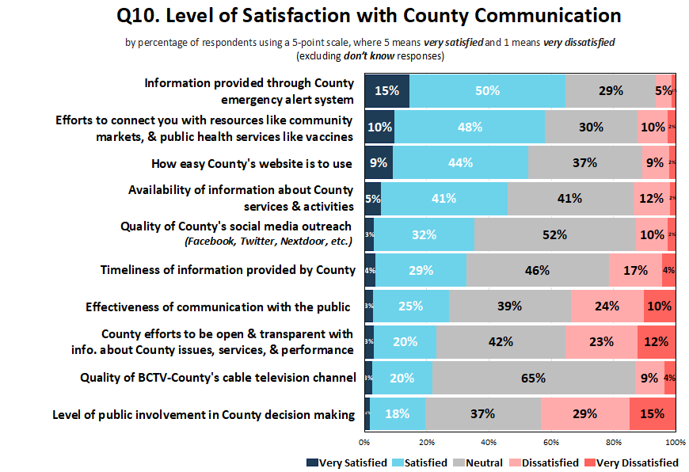
Indicates the item was determined to be a top priority based on Importance-Satisfaction analysis
Notes:
While website is most used/most preferred, county should explore ways to increase engagement
We can ask residents to come to us for information – but we should be providing the most important information in places we already know respondents are going to be

Slide 23
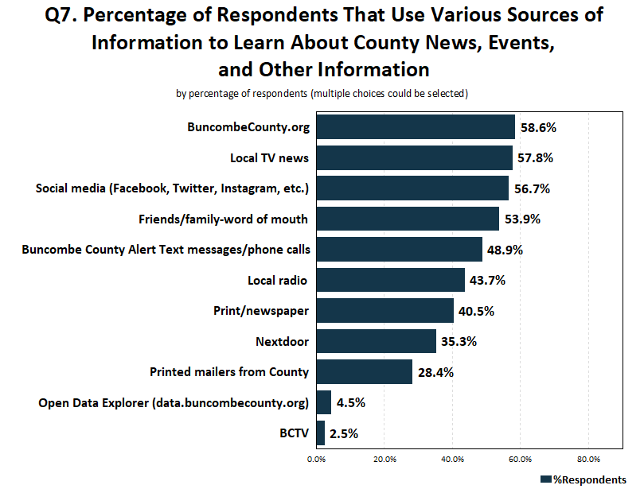
Most residents get information from word of mouth, but less than 1 out of 5 respondents preferred that method

Slide 24
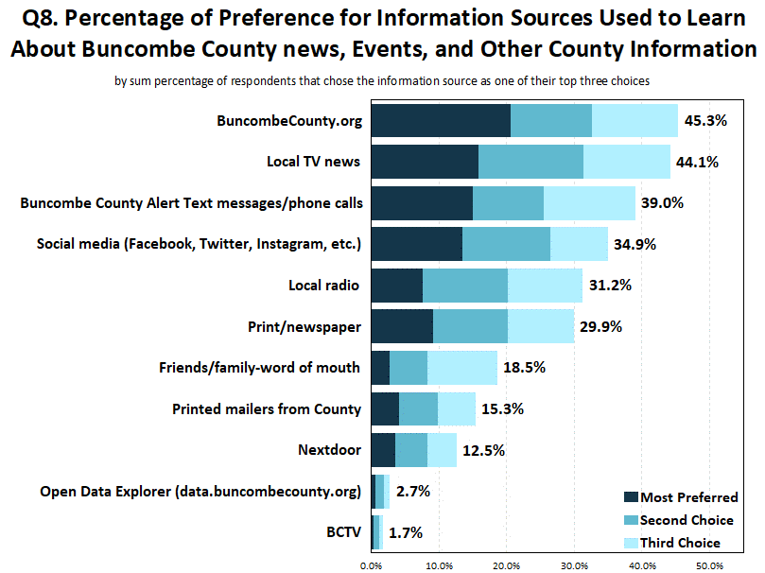

Slide 25
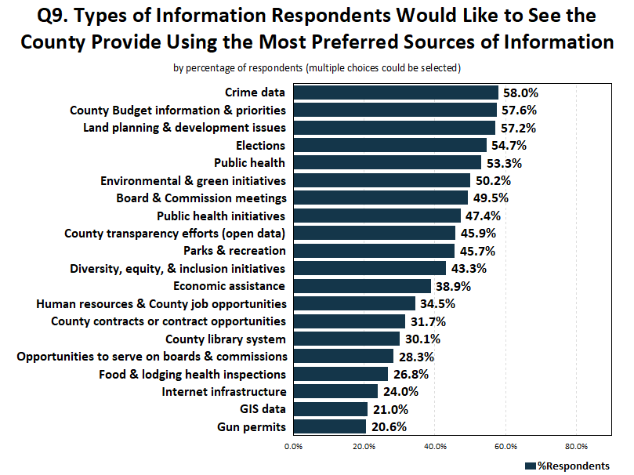

Slide 26
Customer Service
Employees at Buncombe County provide excellent customer service

Slide 27
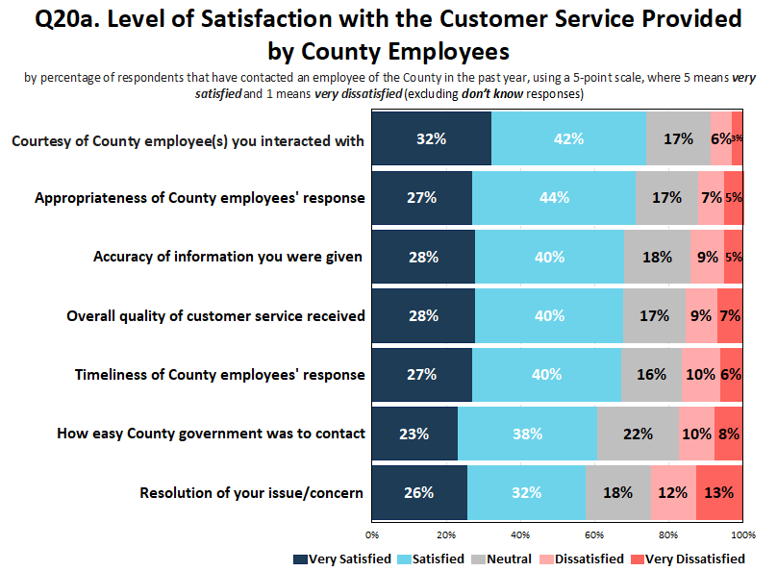
43.3% of respondents indicated they contacted the County within the past year

Slide 28
Additional Findings

Slide 29
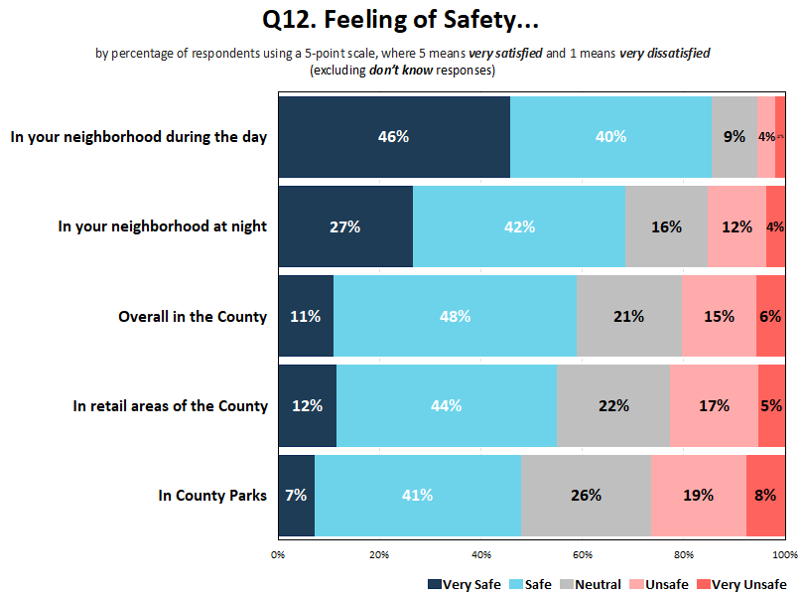

Slide 30
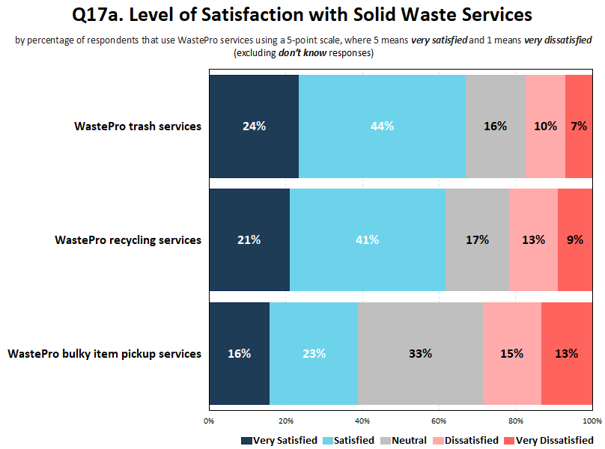
59.9% of respondents indicated they receive solid waste services from WastePro

Slide 31
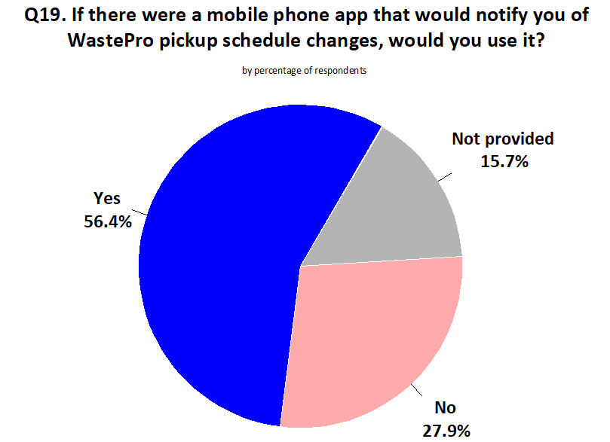
59.9% of respondents indicated they receive solid waste services from WastePro

Slide 32
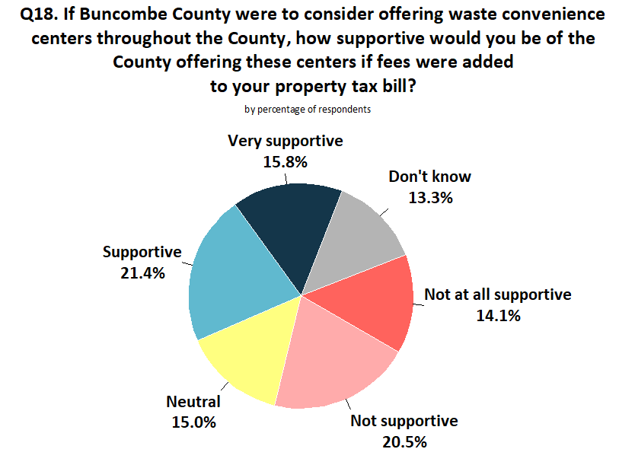

Slide 33
Summary
Residents believe Buncombe County is a great place to visit, but give lower ratings as a place to live, retire, raise children, and work
Employees provide excellent customer service
Core County services received mixed reviews
Communication and public engagement should be a top focus of County leaders over the next 5 years

Slide 34
Questions?
Thank you!

